Slide 1
Data Structures and Algorithms (ESO207A/ESO211)
Lecture 4-5
Heaps

Slide 2
Binary tree
The simplest among the tree data structures (but useful).
Tree has a root node.
Each node has at most two children, left node and right node.
In computer science, trees are represented in an inverted manner: root is at top and leaves
10
root node
Example binary tree whose nodes have integer values
internal node
7 is right child of 10
height =2
9
7
6
4
12
Leaf nodes or leaves

Slide 3
Binary trees
Representation/Notation:
10 is the root.
9 and 7 are the left and right children of 10 respectively.
6 is the left child of 9.
6 is the parent of 11.
2, 4, 12 are leaf nodes.
10
9
7
Height = 4
6
4
12
11
2
Height of a binary tree: the maximum number of links traversed to go from the root to some leaf without using any link twice, that is,
The length of the longest simple path from root to a leaf.

Slide 4
Rooted, Ordered Binary trees
10
9
Tree 2 is the clockwise rotation of Tree 1 around 9.
9
7
6
10
6
4
12
11
7
11
4
12
2
2
Tree 1
Tree 2
These two trees have the same set of nodes.
But they are different, since parent-child relation is different.
In Tree 1, 10 is the parent of 9.
In Tree 2, 9 is the parent of 10.

Slide 5
Rooted, Ordered trees
10
10
9
7
7
9
6
11
4
12
4
12
6
11
Tree 2
Tree 1
Tree 1 and Tree 2 are different because,
In tree 1, 9 is the left child of 10.
In tree 2, 7 is the left child of 10.
(Also, vice-versa, in tree 1, 7 is the right child of 10 and 9 is the right child of 10 in tree 2.)
Summary: two trees are identical only if they have the same root and the same parent-leftchild, parent-rightchild relations for all nodes

Slide 6
Representing trees
There are several ways to represent trees on a computer.
A standard way is outlined, but for heaps, we will use just an array.
Define a structure
struct treenode { // a binary tree node
/* put attributes of interest here */
/* int key; float value; …. */
struct treenode *lchild; // pointer to left child
struct treenode *rchild; // pointer to right child
}
Data
lchild
rchild
A tree node structure

Slide 7
10
·
10
·
9
7
9
7
·
·
·
·
6
11
4
12
6
11
4
12
Tree: Schematic description
NIL
NIL
NIL
NIL
NIL
NIL
NIL
NIL
As represented on the computer
NIL denotes the 0 pointer (NULL in C, or equivalent).

Slide 8
Complete Binary Trree
Number of nodes at level 0 (root) = 1
Number of nodes at level 1 = 2
Number of nodes at level 2 = 2²
… and so on.
A binary tree of height h has at most
1 + 2 + 2² + … + 2^{h} = 2^{h+1} -1
nodes for h ≥ 0.
A binary tree is said to be complete if it is of height h and has the maximum possible 2^{h+1} -1 number of nodes.
All levels are fully occupied.
10
9
7
level 1
6
11
4
12
level 2 nodes
A complete binary tree

Slide 9
Simple path
9
A simple path from a node to another is a path in which no edge is repeated.
The path 8—6—11—2 is a simple path from 8 to 2.
In a tree, there is always a unique simple path between any pair of nodes.
6
10
11
7
8
4
12
2

Slide 10
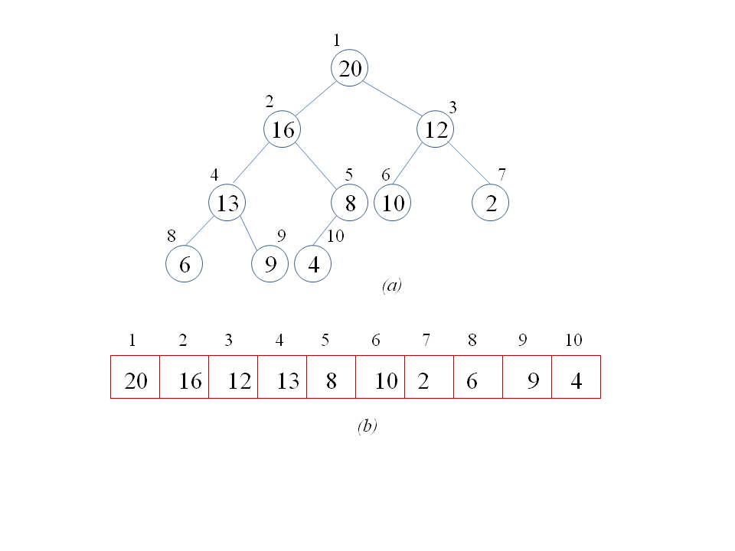
Heaps
A heap is an array object i.e., represented as an array.
We view a heap as a nearly complete binary tree.
A heap viewed as a nearly complete binary tree
Array A
Same heap stored in an array A

Slide 11
“Nearly” complete binary tree
A binary tree of height h say.
Levels 0 through h-1 are fully occupied
Level h is partially occupied, but contiguous from the left.
20
15
17
16
10
9
8
6
12
8
An example of a nearly complete binary tree

Slide 12
Embedding “nearly” complete binary trees
Basic Indexing of the tree in array
The main advantage of nearly complete binary trees is that it is easily represented directly in an array.
Parent(i) {
return i/2
}
Left(i) {
return 2i
}
Right(i) {
return 2i+1
}
Level-wise embedding of tree
Root of tree is A[1]
A
Parent of node at index i is at . Left and right children of node at index i are at 2i and 2i+1 respectively.

Slide 13
Heap Parameters: Heapsize and Length
A.heapsize represents the number of elements in the heap.
A.length represents the size of the array A (its capacity).
Heap data structure should maintain
0 ≤ A.heapsize ≤ A.length
This must be maintained while inserting into heap.
Here,
A. heapsize = 10
Heap A

Slide 14
Heap Property
Max heap property: The value at a node is no smaller than the values of its children nodes: A[Parent(i)] ≥ A[i]. This holds for all nodes in the tree.
There is another kind of heap: Min heap. In a min-heap, the min-heap property is satisfied: the value at a node is no larger than the values of its children nodes:
A[Parent(i)] ≤ A[i] (holds for all nodes).
20
A
20
15
17
16
10
9
8
6
12
8
16
17
Max-heap property is a “weak” property. We will see that it is easy to maintain.
It is called max-heap since
value at a node is at least as large as the value of its children.
the root node contains a largest value.
15
10
9
8
6
12
8

Slide 15
Heap Data Structure Operations
Heaps satisfy the following basic operations:
Max-Heapify. Runs in O(log n) time and is key to maintaining the max-heap property.
Build-Max-Heap. Runs in linear time and produces a max-heap from an unordered (arbitrary) array.
Heapsort. Runs in O(n log n) time. Sorts array in place.
Max-Heap-Insert, Heap-Extract-Max, Heap-Increase-Key, each run in O(log n) time.

Slide 16

Digression: Data Structures
A data structure organizes some data, such as a set of elements, and supports some set of operations efficiently.
Not all operations on the data may be supported.
E.g., in Heap data structure, Search(A,x) is not supported.
Meaning that Search(A,x) may not be efficient in a heap, not that it would be impossible.
Supporting a set of operations on data, is the problem of structuring the data on the computer to enable efficiency of those operations.
Back to Heaps…

Slide 17
Heap Data Structure Operations
Heaps satisfy the following basic operations:
Max-Heapify. Runs in O(log n) time and is key to maintaining the max-heap property.
Build-Max-Heap. Runs in linear time and produces a max-heap from an unordered (arbitrary) array.
Heapsort. Runs in O(n log n) time. Sorts array in place.
Max-Heap-Insert, Heap-Extract-Max, Heap-Increase-Key, each run in O(log n) time.
We will now design these operations for Max-Heap. Min-heaps are dealt with symmetrically.

Slide 18
Max-Heapify
Max-Heapify (A, i): assumes that the input satisfies the following:
The binary trees rooted at Left(i) and Right(i) are themselves max-heaps.
But A[i] may be smaller than its children.
Output: Reorders the elements in array so that max-heap property is satisfied by all nodes in the binary tree rooted at i.
1
20
Call Max-Heapify (A,i), with i =2.
Node 2 violates max-heap property.
Strategy: Exchange A[i] with the larger of
Left(i) and Right (i). Set i to the child node we exchanged with.
Now recurse.
2
3
5
17
4
5
6
7
16
10
9
8
8
9
10
6
12
8

Slide 19
1
1
20
Exchange 5 with 16 (larger of 16 and 10).
20
2
3
2
3
5
17
16
17
4
5
6
7
16
10
9
8
4
5
6
7
5
10
9
8
8
9
10
6
12
8
8
9
10
6
12
8
Call Max-Heapify(A,2)
Exchange 5 with 12 (larger of 12 and 6).
Call Max-Heapify(A,4)
1
1
20
20
2
3
2
3
16
17
16
17
4
5
6
7
4
5
6
7
12
10
9
8
No change
12
10
9
8
8
9
10
8
9
10
6
5
8
6
5
8
Call Max-Heapify(A,9)

Slide 20
Max-heapify(A,i) { // Possible violation of max-heap property at A[i]
l = Left(i)
r = Right(i)
if l ≤ A.heapsize and A[l] > A[i]
largest = l
else largest = i
if r ≤ A. heapsize and A[r] > A[largest]
largest = r
if largest ≠ i {
exchange A[i] with A[largest]
Max-Heapify(A,largest)
}
Finds the index among i, Left(i) and Right(i) with the largest value.
If largest index is equal to i, terminate—no violation
Otherwise, exchange A[i] with A[largest]. Recursively call Max-Heapify(A,largest)
Number of calls to Max-heapify
We either terminate in a call or proceed down the tree by one level.
Each call requires O(1) time.
Number of calls ≤ height(i)+1. Total time: O(height(i)).

Slide 21
Height of a node, heap
In a heap, the height of a node is the number of edges on the longest simple downward path from the node to any leaf.
Height of a heap with n elements:
Height = h, n = 2^{h}
Hence h ≤
So Max-heapify(A,i) works in
time O(height(i)) = O(log n).
20
Height of 15 = 2
Height of 20 = 3
Height of 12 = 0
16
17
15
10
9
8
20
6
12
8
16
17
15
10
9
8
6
Worst case heap with largest height as a function of n.

Slide 22
Building a Heap
Build-Max-Heap(A,n) {
for i = n/2 downto 1 {
Max-Heapify(A,i)
}
A.heapsize = n
}
What does Build-Max-Heap(A) do?
It simply calls Max-Heapify on every non-leaf node going up the tree.
Loop Invariant.
When Max-Heapify(A,i) is called in line 2, each node i+1,i+2, …, n is the root of a max-heap.
Implies: the left and right subtrees of node i are each max-heaps.
Proof of Loop invariant: Max-Heapify(A,i) ensures that the subtree rooted at node i is a max-heap, provided the left and right sub-trees of node i were already max-heap.
At end of each iteration, the subtree rooted at i is a heap.
Hence upon termination, the tree rooted at 1 is a heap.

Slide 23
Analysis of Build-Max-Heap
A simple analysis: there are n calls to Max-Heapify and each call requires time O(log n).
Hence time required is O(n log n).
Correct, but conservative.
20
Two facts:
An n-element heap has height at most
(proved earlier).
Number of nodes of height 0 =
Number of nodes of height 1 ≤
…
Number of nodes of height h ≤
16
17
15
10
9
8
6
12
8
Leaf nodes of an n-node heap are numbered from
,…, n.

Slide 24
Build-Max-Heap: Analysis
Number of nodes at height h is at most ceil(n/2^{h+1} ).
Cost of Max-Heapify(A,i) for a node i at height h is O(h).
So total cost is:

Slide 25
Heapsort
Given an array A[1..n]. Set A.heapsize = n.
Call Build-Max-Heap to transform A into a max-heap.
Repeat from i=1 to n-1
Exchange A[1] with A[A.heapsize].
Call Heapify(A,1).
Decrement A.heapsize.
A[1] is largest element among A[1..heapsize]. So we exchange A[1] and A[heapsize].
Heapify(A,1).
Now repeat for A[1…heapsize-1].
Heapsort(A,n) {
Build-Max-Heap(A,n)
A.heapsize = n
for i=1 to n {
Exchange A[1] with A[heapsize]
A. heapsize = A.heapsize -1
Max-Heapify(A,1)
}

Slide 26
20
8
Exchange A[1] with
A[heapsize]
16
17
16
17
15
10
9
8
15
10
9
8
In correct sorted position
6
12
8
6
12
20
16
17
15
10
9
8
6
12
8
8
16
17
15
10
9
8
6
12
20
Heap of 10 elements
Incorrect heap of 9 elements
Heapify(A,1)
17
17
16
9
15
10
8
8
6
12
20
16
9
Corrected heap of 9 elements
15
10
8
8
6
12

Slide 27
17
12
Exchange A[1]
with A[heapsize]
16
9
16
9
15
10
8
8
15
10
8
8
6
12
6
sorted
17
16
9
15
10
8
8
6
12
20
12
16
9
15
10
8
8
6
17
20
Corrected heap of 9 elements
Incorrect heap of 8 elements
Heapify(A,1)
16
15
9
12
10
8
8
6
17
20
16
Heap of 8 elements
15
9
12
10
8
8
And so on…
6

Slide 28
Analysis of Heapsort
Build-Max-Heap takes O(n) time.
In each iteration of the loop, there is one call to Max-Heapify, that takes O(log n) time.
There are n iterations, so Heapsort takes O(n) + O(n log n) = O(n log n) time.

Slide 29
Priority Queues: a data structure
Data structure is data organized in some form that supports a given set of operations efficiently.
The max-priority-queue data structure maintains a dynamic set S of elements,
Each element has associated with it a value key.
The data structure supports the following operations.
Insert(S,x) inserts the element x into S to get S U {x}.
Maximum(S) returns the element of S with the largest key.
Extract-Max(S) removes and returns the element from S with the largest key value.
Increase-Key(S,x,k) increases the value of elements x’s key to a new value k, assumed to be no smaller than its current key value.

Slide 30
Implementing Priority Queue by Heap
Maximum(A) {
return A[1]
}
A[1] is the largest element. Return A[1].
Time taken=O(1)
Extract-Max(A) {
If A.heapsize == 0
error “Empty Heap”
max = A[1]
A[1] = A.heapsize;
A.heapsize= A.heapsize-1;
Max-Heapify(A,1)
return max
}
Remember A[1] in max.
Replace A[1] by A[heapsize].
Decrement A.heapsize.
This possibly violates max-heap property at node 1.
So call Max-Heapify.
Time taken = O(log n).

Slide 31
Increase-Key(A, i, key) {
If key < A[i]
return “new key smaller than current key”
A[i] = key
while i > 1 and A[Parent[i]] < A[i] {
Exchange A[Parent[i]] with A[i]
i = Parent(i)
}
}
// increase A[i] to a new value key.
Push Violation up the tree
Iteration stops when i equals root since there is no violation at root.
Check if the key value is being increased. Error otherwise.
Set A[i] to new (higher) value key.
A[i] possibly violates max-heap property at node i, that is, A[Parent[i]] could be < A[i].
If so, exchange A[Parent[i]] with A[i].
Set i to Parent(i) and loop.
Number of iterations ≤ distance of i from root ≤

Slide 32
Increase Key (A,4,25)
20
20
Heap property violated.
16
17
16
17
Increase-Key (25)
15
10
9
15
25
10
9
15
6
12
8
6
12
8
20
16
17
15
10
9
8
6
12
8
20
16
17
25
10
9
8
6
12
8
25
Heap property violated.
20
No violation
20
17
25
17
16
10
9
15
16
10
9
15
6
12
8
6
12
8
25
20
17
16
10
9
8
6
12
8
20
25
17
16
10
9
8
6
12
8
32

Slide 33
Simple exercises
Give an algorithm for Heap-Delete(A,i) to delete the item in node i from heap A.
Give an O(n log k) algorithm for merging k sorted lists (arrays) into one sorted list, where n is the total number of elements in all the input lists. (Hint: use a min-heap for merging the k sorted lists).
Given a max-heap A, can you give an algorithm for Decrease-Key(A,i, k)?
Note: The elements of a heap need not only be numbers, they can be more complex types. But each element must have a key value from a totally ordered domain (that is two keys may be compared to get <, = or > ).

